Slide 1
Lesson 7
JOEL PONZIO
Mission Design

Slide 2
Feedback Design
Mission Design
World Design
Progression Design
Puzzle Design
Cinematic Design
Boss Design
Feedback Design

Slide 3
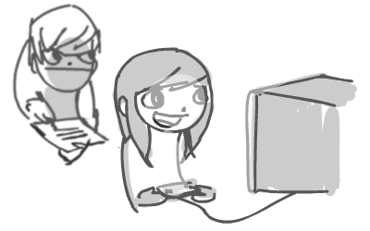
Feedback Design
How to give / get effective feedback
Create and connect a pressure plate to the Block
How to create UI Interface Widget
How to implement (fake) seamless camera movements

Slide 4
Feedback Design
Effective Feedback
Pressure Plate
UI Interface Widget

Slide 5
Feedback Design
Testing Levels
Break them!

Slide 6
Feedback Design
Testing Levels
Why testing is important?

Slide 7
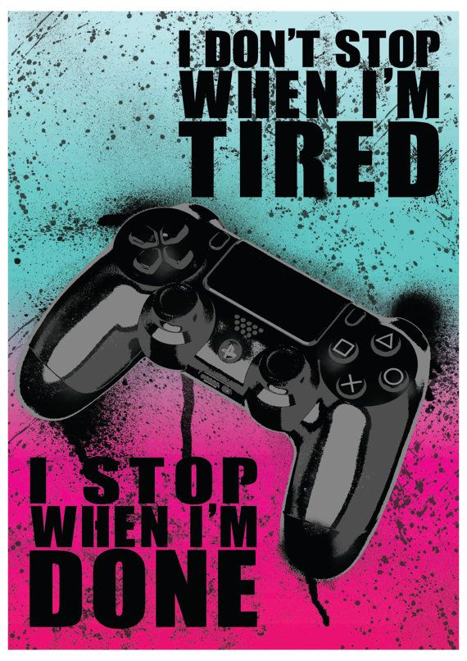
Feedback Design
Testing Levels
Is it fun?
How hard is it?
Are there simpler solutions?
Can It be improved?

Slide 8

Feedback Design
Peer Review
First line of defense in feedback
Get another professional’s opinion
Put ego aside
Swallow your pride
Don’t take it personal

Slide 9
Feedback Design
Receiving Peer Review
Grab another level designer
Have them play your content
Give them a minimal amount of explanation
During their playthrough:
Watch what they’re doing extensively
Write everything down
Shut up
After their playthrough:
Ask them unbiased questions
Write everything down
Don’t get defensive
Stay motivated

Slide 10
Feedback Design
Giving Peer Review
“The combat encounter had great pacing, but the layout was too flat and boring. I had a great time during the chase beat.”
During a playthrough:
Play as how you’d usually play
After the playthrough:
Be honest
Be critical
Be constructive
Master the compliment sandwich if you find being critical is hard

Slide 11
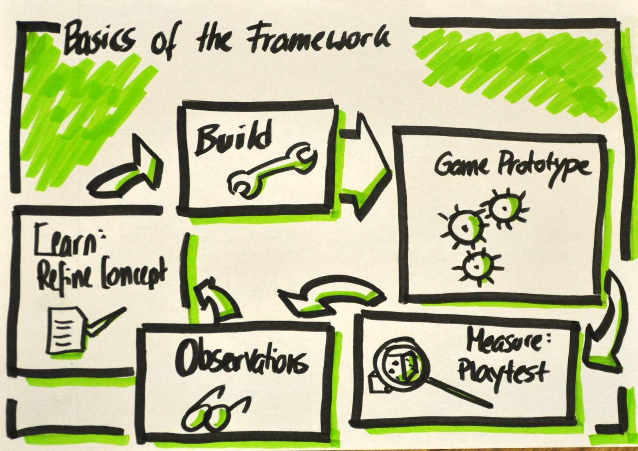
Feedback Design
5’
Playtest Form
Grab a pen and a notebook
Write down at least 5 questions that you want to ask to playtesters
Try to find out what you could polish even more
Don’t be afraid of asking!

Slide 12
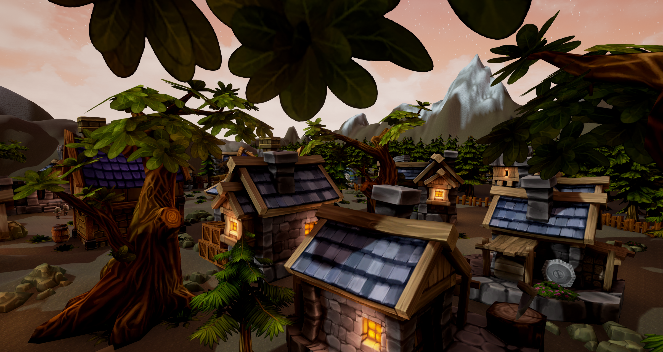
Feedback Design
40’
Last(-ish?) playtest before Final
Wait for us to pair you up with a peer
Let him play your level
Take notes
Shut up
Ask him questions and take notes
Switch roles

Slide 13
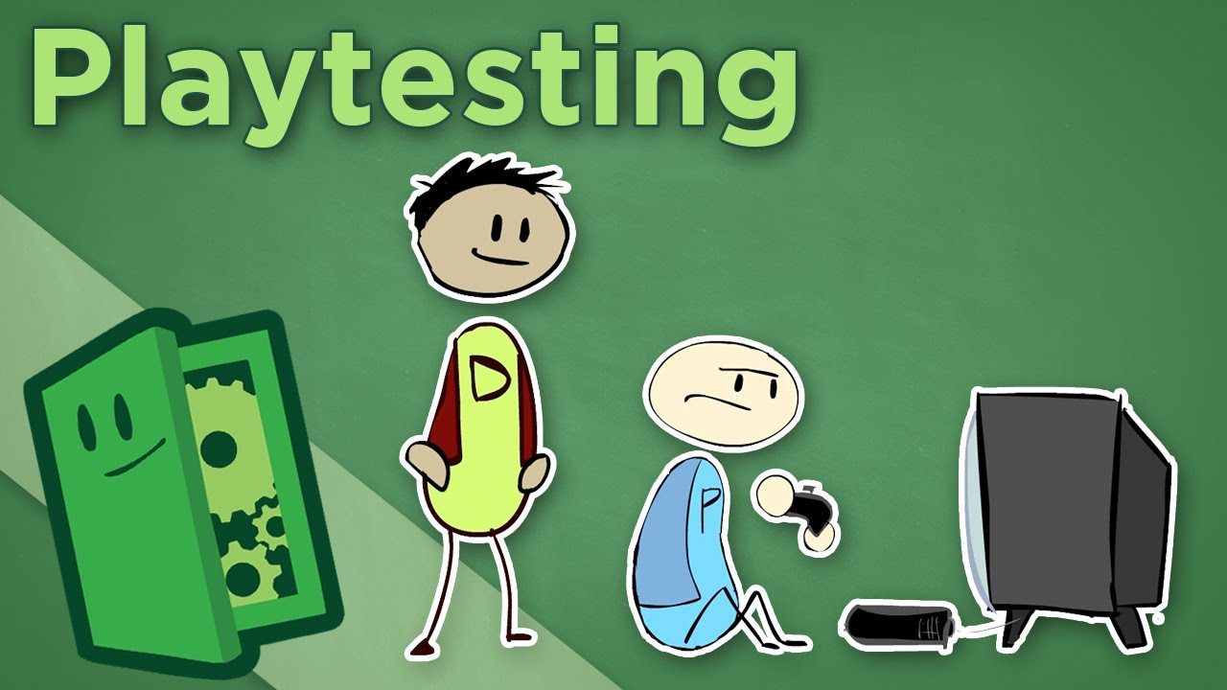
Feedback Design
Bonus: How to Get Good Feedback
User feedback is one of the most important steps in the iterative design process
Too often designers shy away from it due to insecurity
Don't be afraid--your game will only get better with quality feedback
Learn how to ask
Watch me!

Slide 14
Polish
Tutorial: Pressure Plate

Slide 15
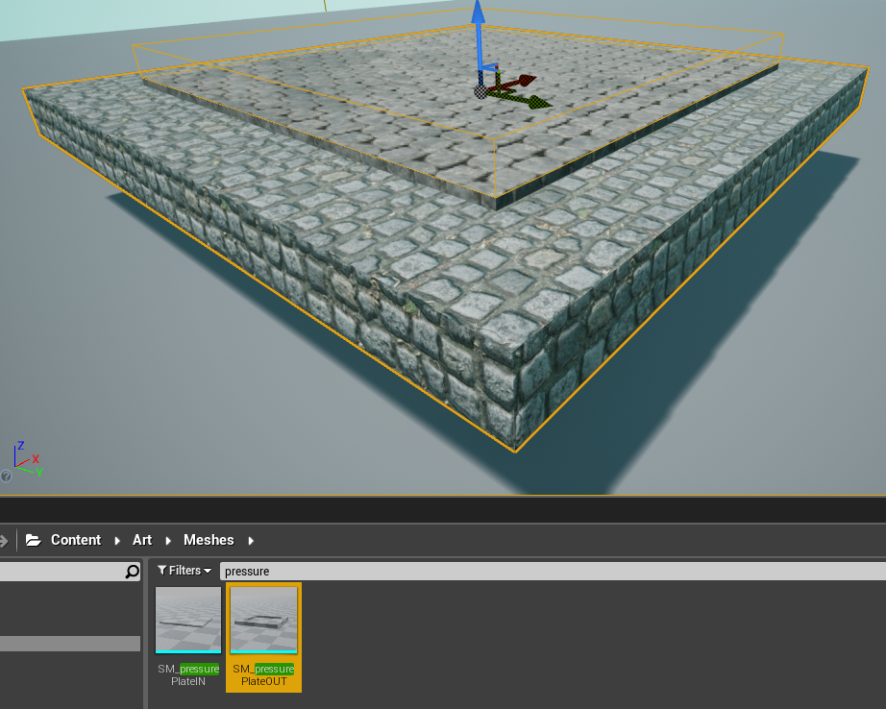
Tutorial: Pressure Plate

Slide 16
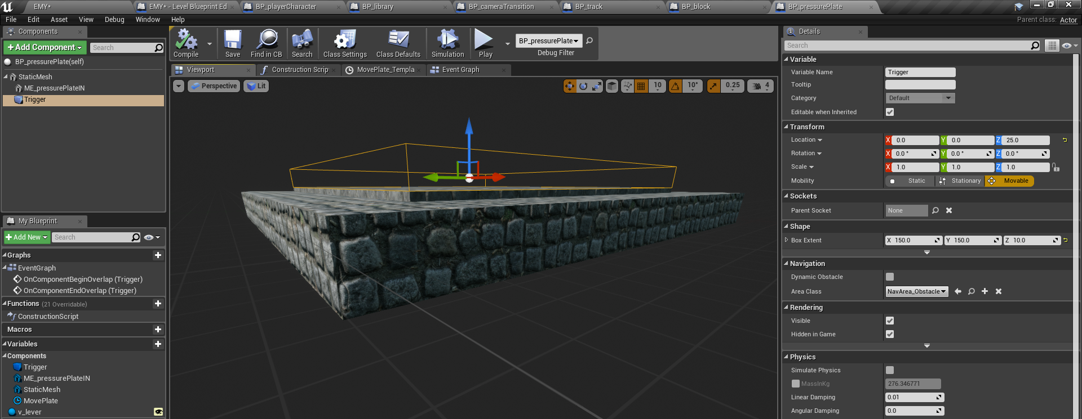
Polish
Tutorial: Pressure Plate

Slide 17
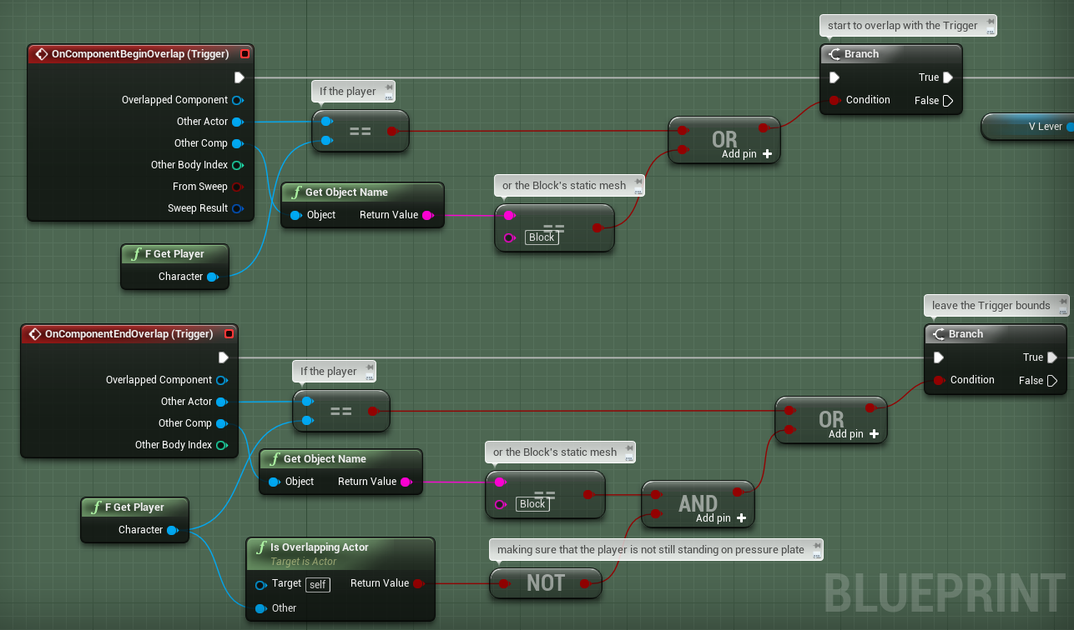
Polish
Tutorial: Pressure Plate

Slide 18
Polish
Tutorial: Pressure Plate

Slide 19
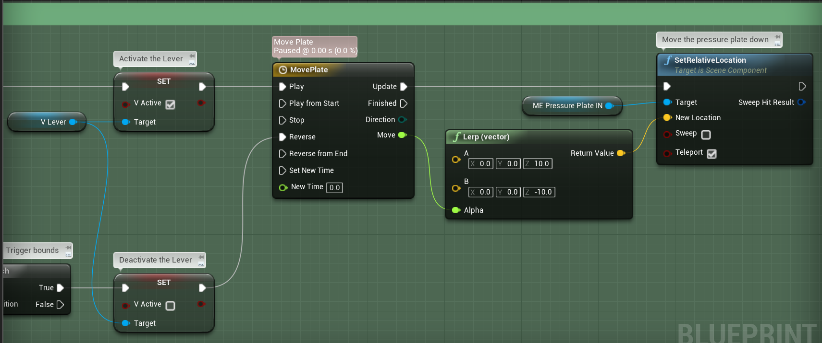
Polish
Tutorial: Pressure Plate

Slide 20
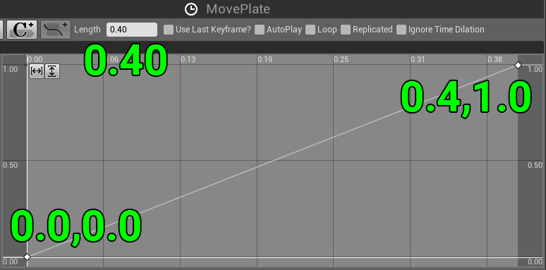
Polish
Tutorial: Pressure Plate

Slide 21
Feedback Design
Tutorial: Create UI Interface Widget

Slide 22
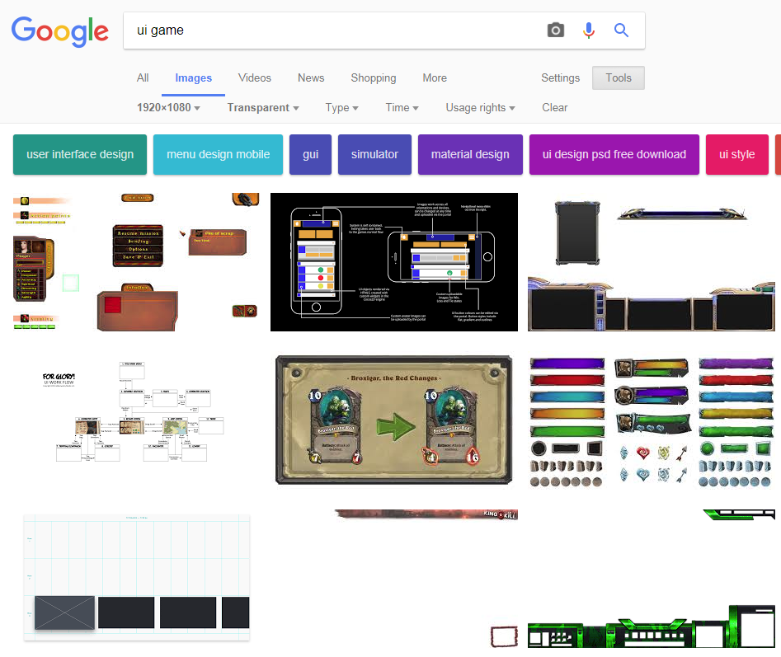
Create UI Interface Widget

Slide 23
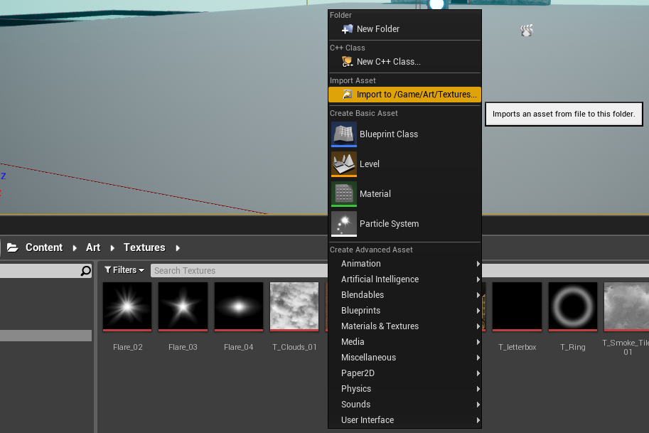
Create UI Interface Widget

Slide 24
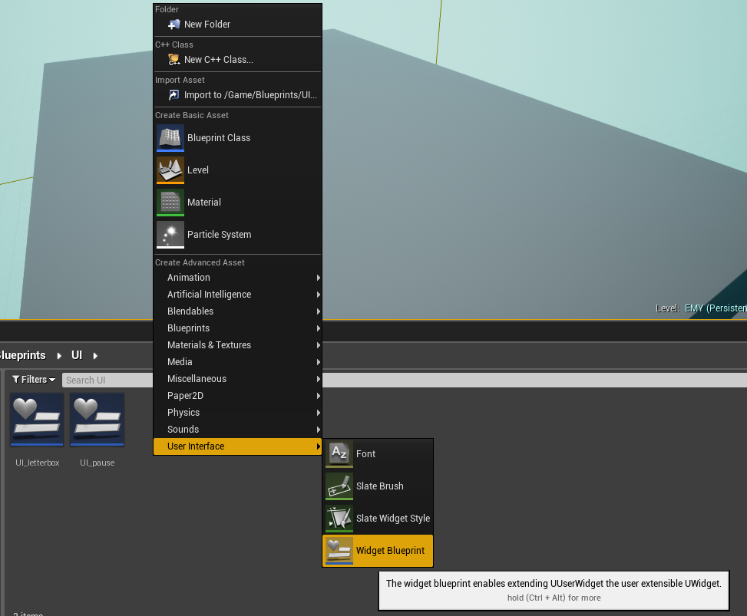
Create UI Interface Widget

Slide 25
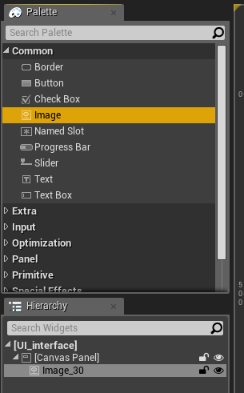
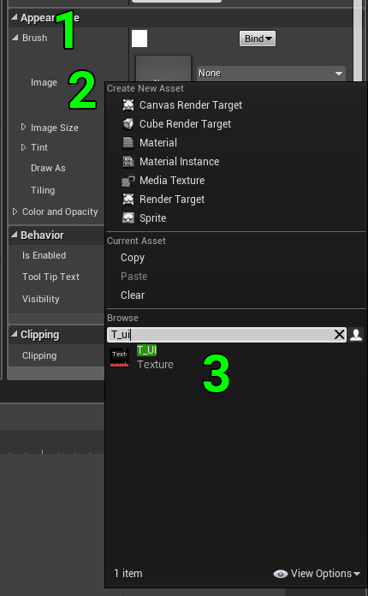
Create UI Interface Widget

Slide 26
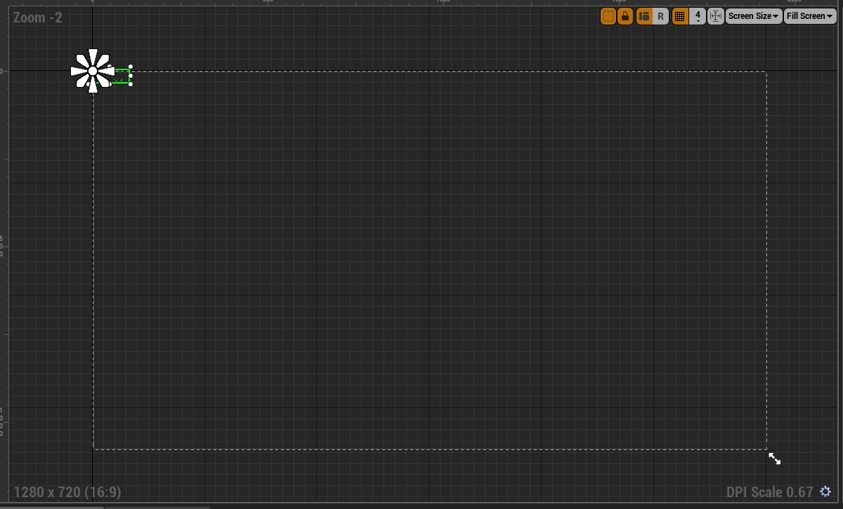
Create UI Interface Widget

Slide 27
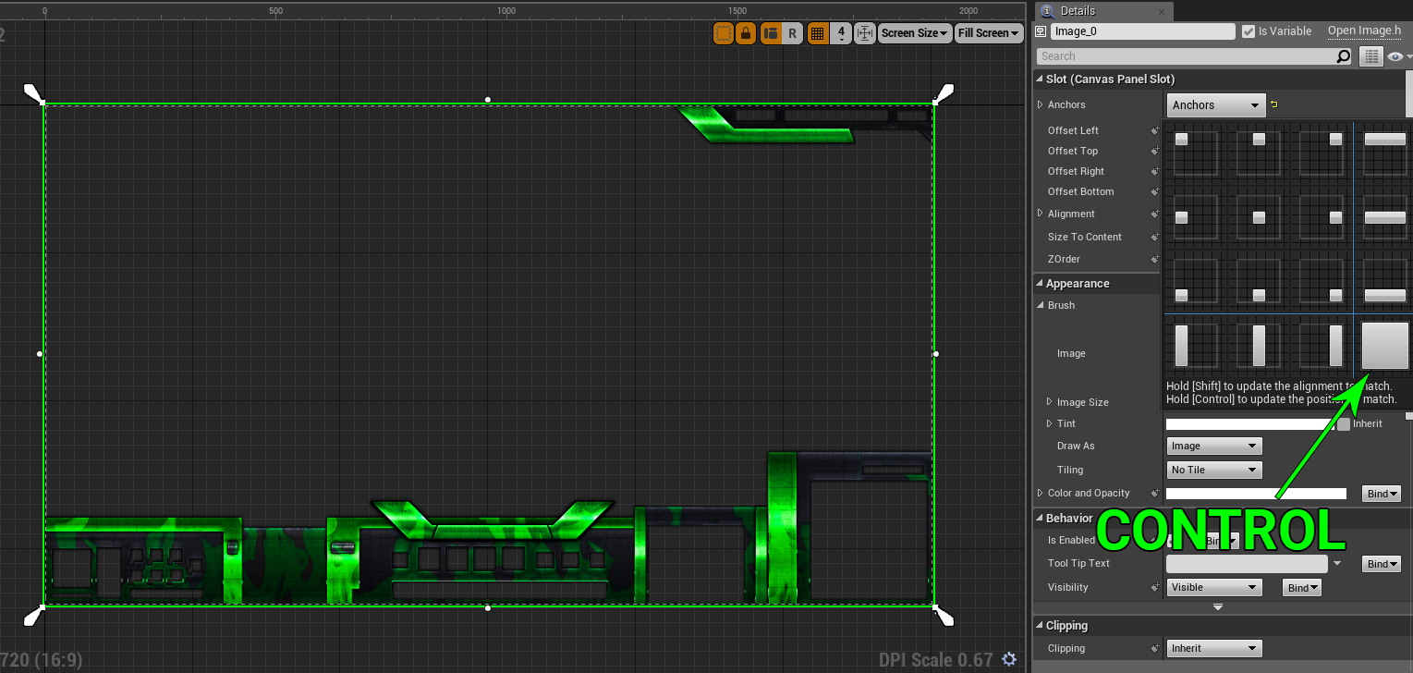
Create UI Interface Widget

Slide 28
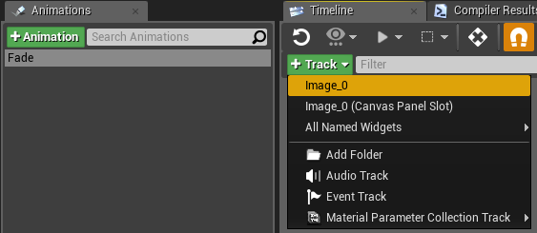
Feedback Design
Create UI Interface Widget

Slide 29
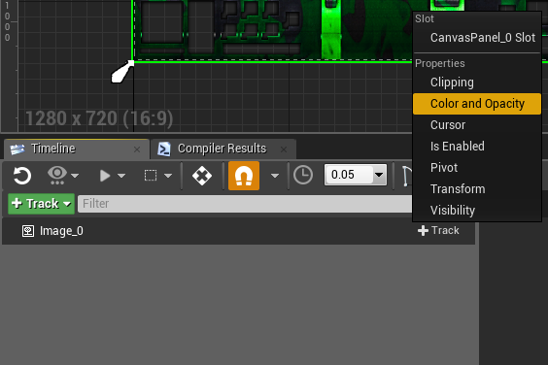
Create UI Interface Widget

Slide 30
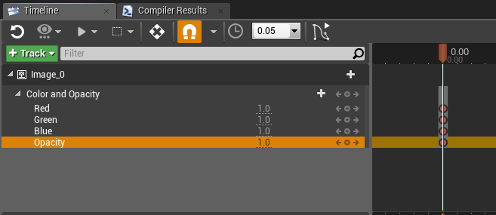
Feedback Design
Create UI Interface Widget

Slide 31
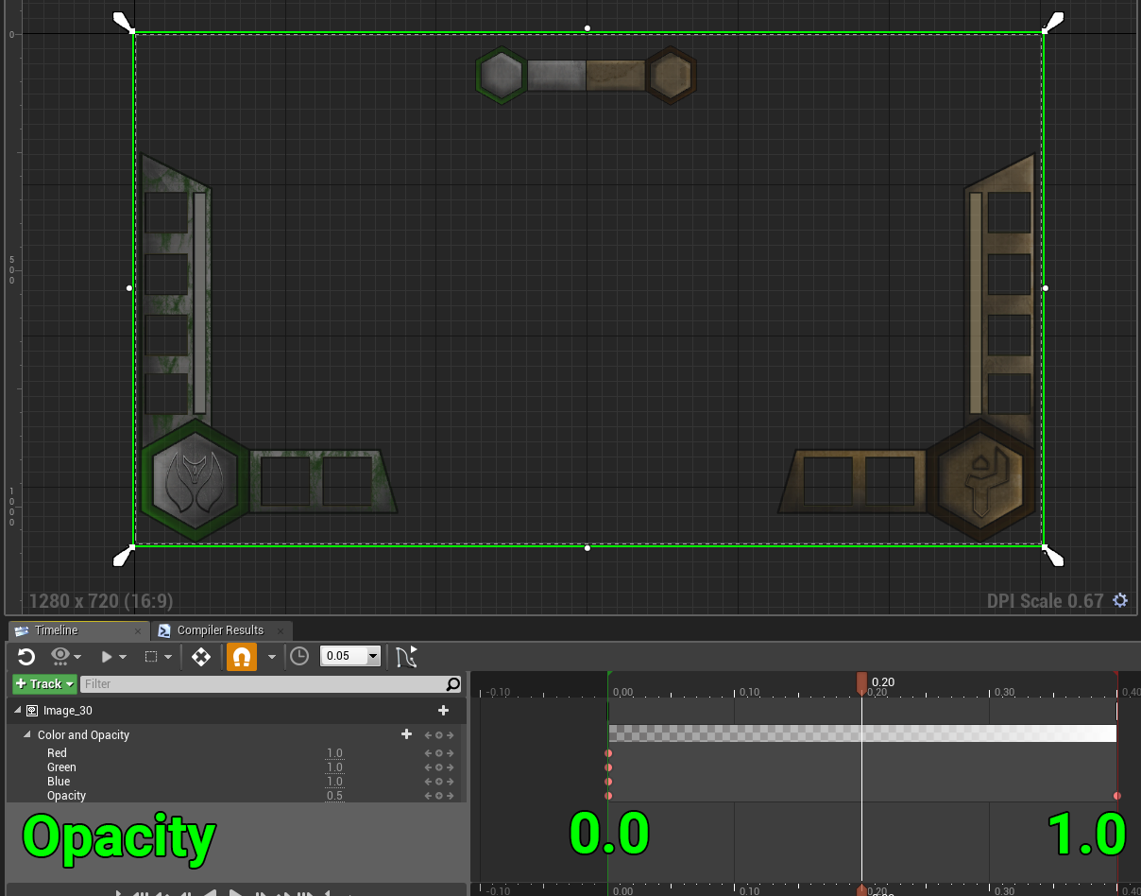
Create UI Interface Widget

Slide 32
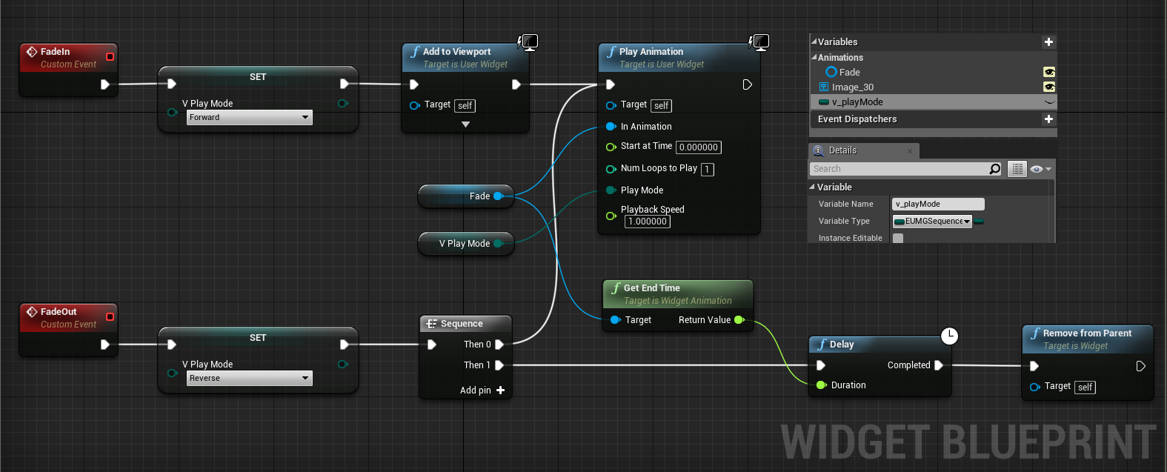
Create UI Interface Widget

Slide 33
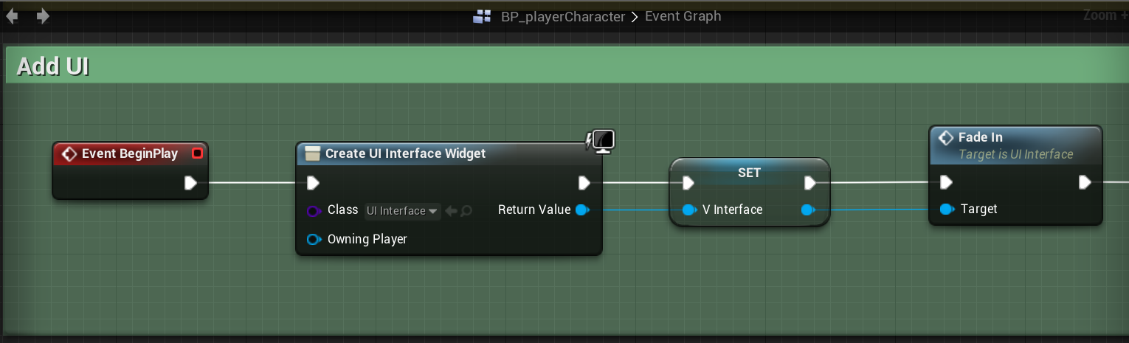
Feedback Design
Create UI Interface Widget

Slide 34
Feedback Design
Tutorial: Pause Menu

Slide 35
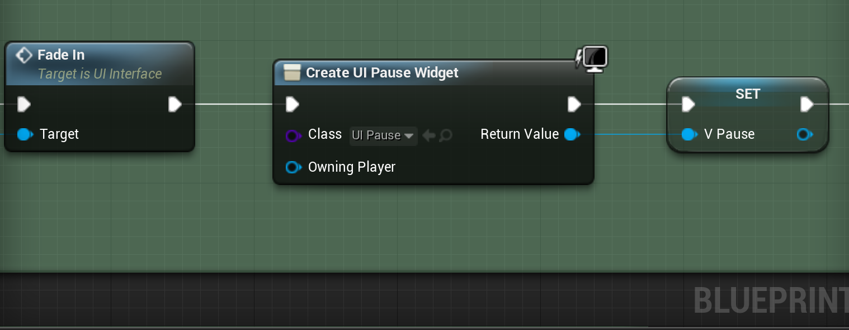
Feedback Design
Tutorial: Pause Menu

Slide 36
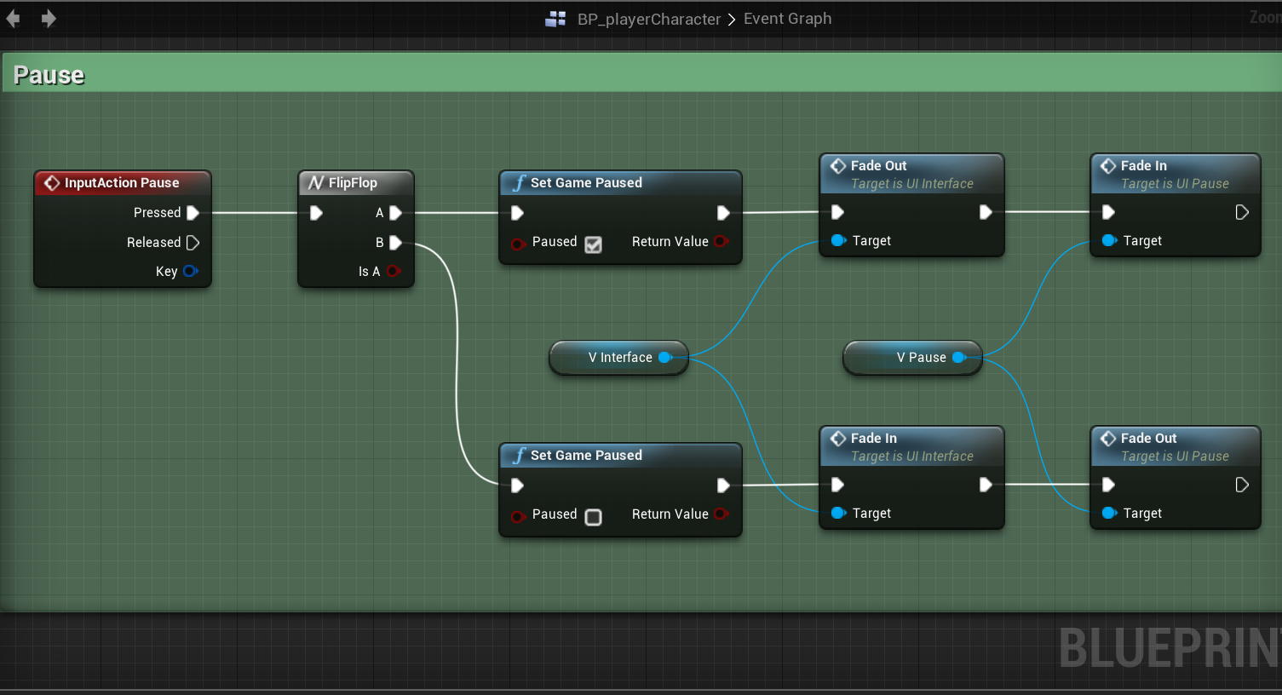
Tutorial: Pause Menu

Slide 37
Feedback Design
Tutorial: Quit Game

Slide 38
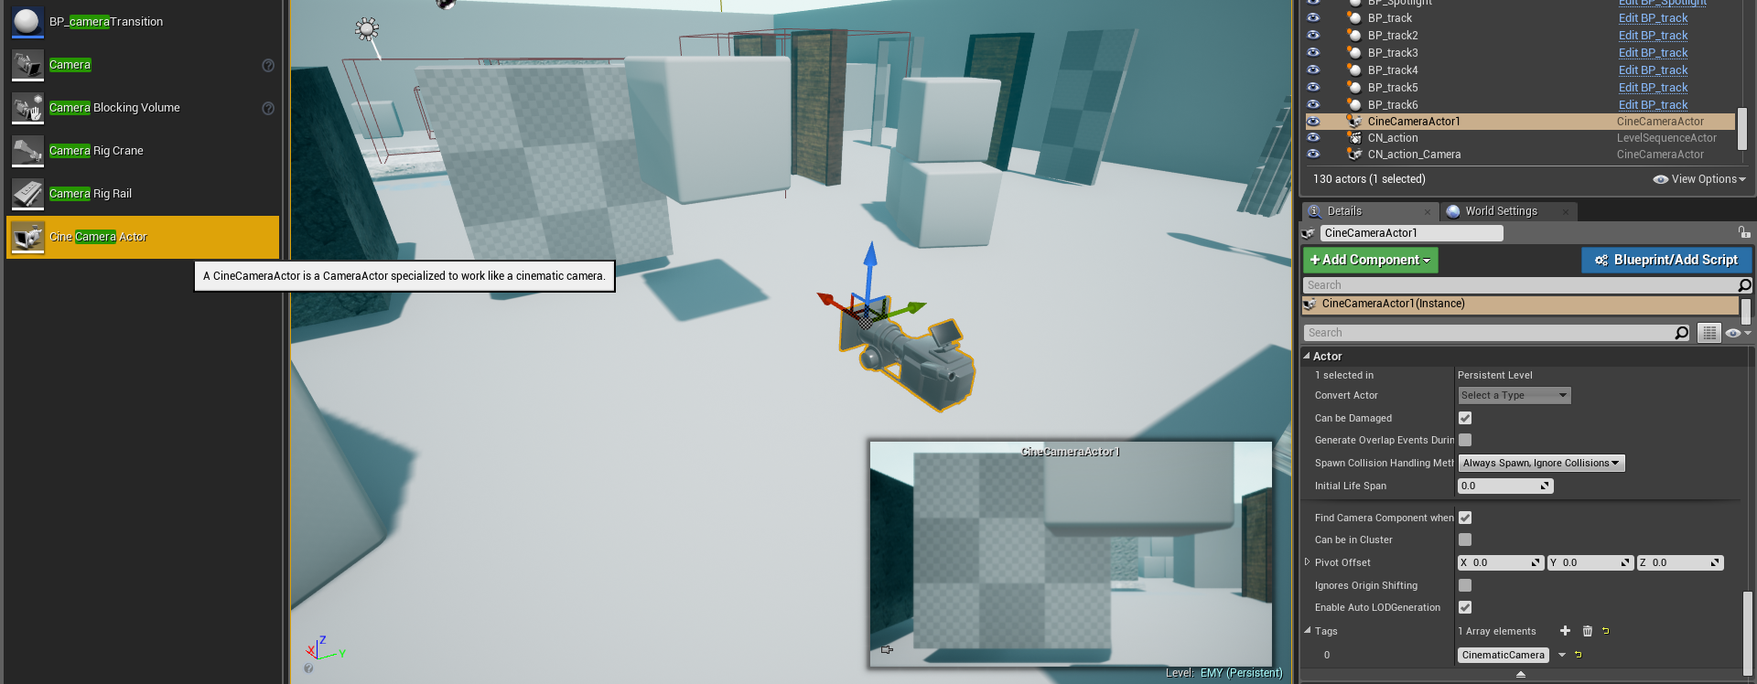
Feedback Design
Tutorial: Quit Game

Slide 39
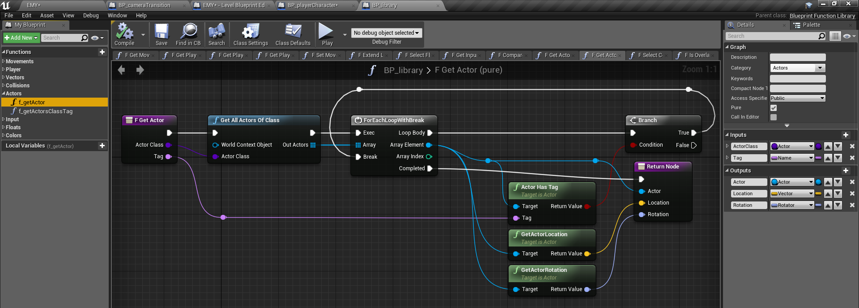
Feedback Design
Tutorial: Quit Game

Slide 40
Feedback Design
Tutorial: Quit Game

Slide 41
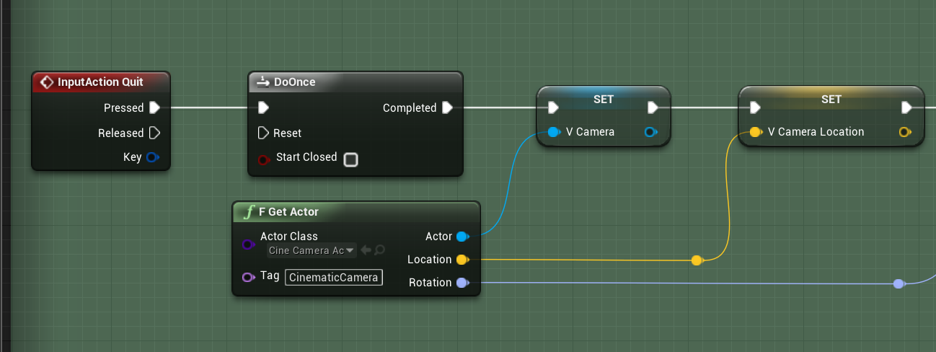
Feedback Design
Tutorial: Quit Game

Slide 42
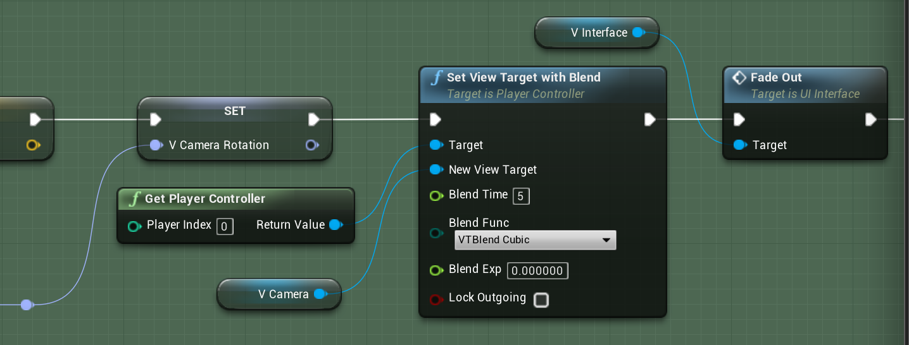
Feedback Design
Tutorial: Quit Game

Slide 43
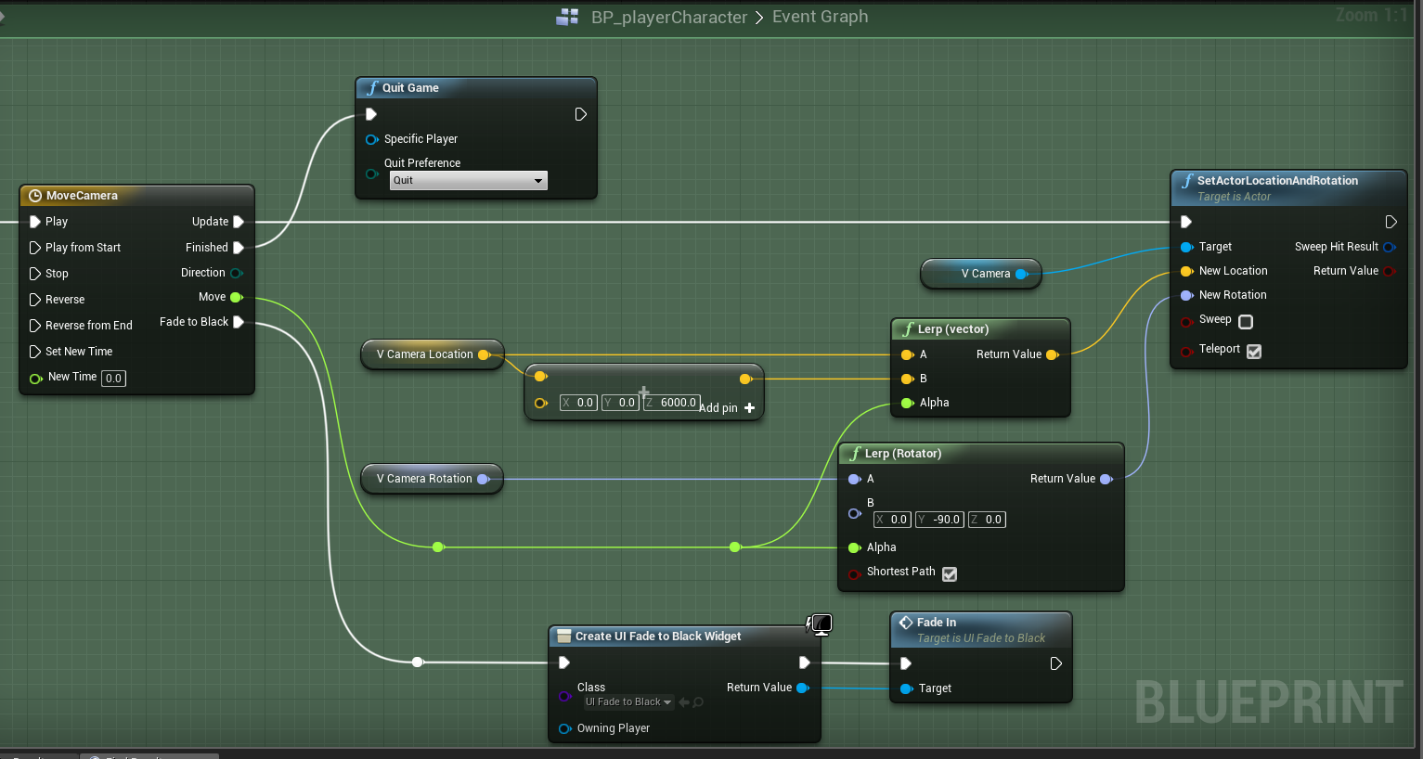
Tutorial: Quit Game

Slide 44
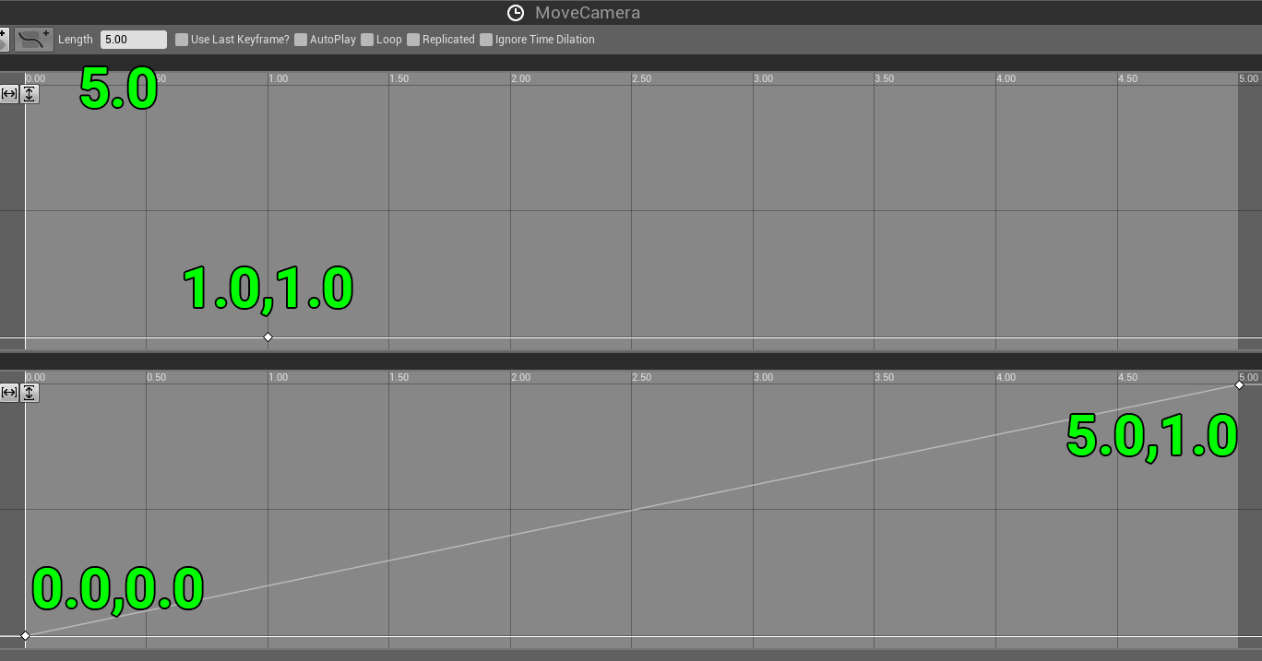
Tutorial: Quit Game

Slide 45
Tutorial: Quit Game

Slide 46
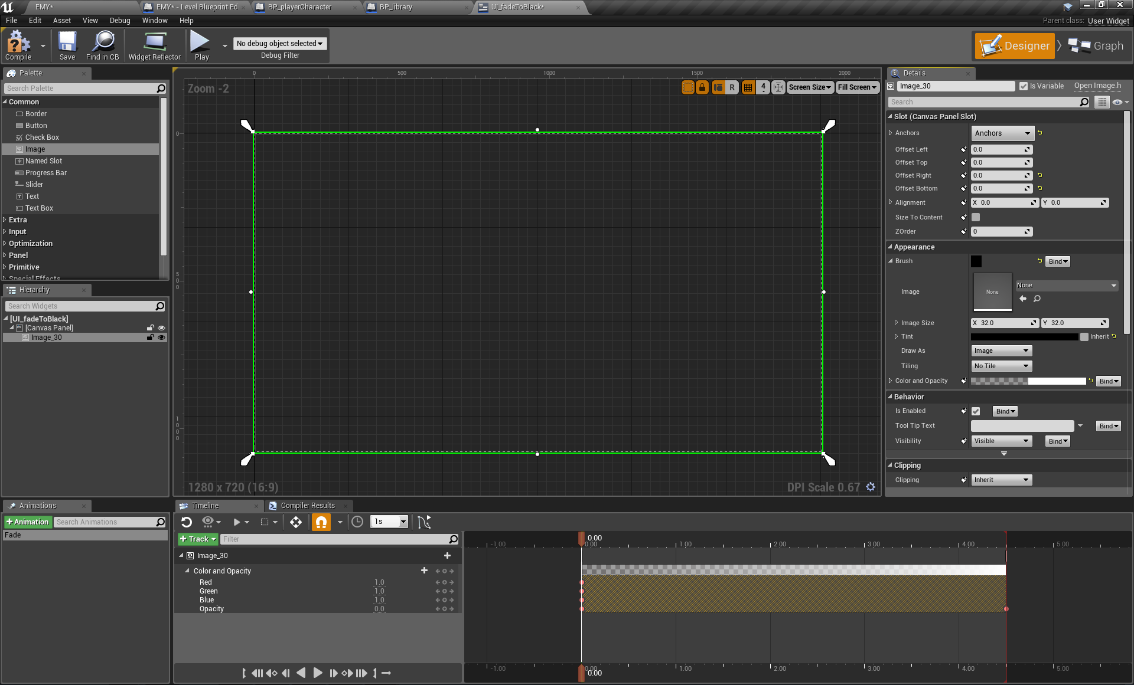
Tutorial: Quit Game

Slide 47
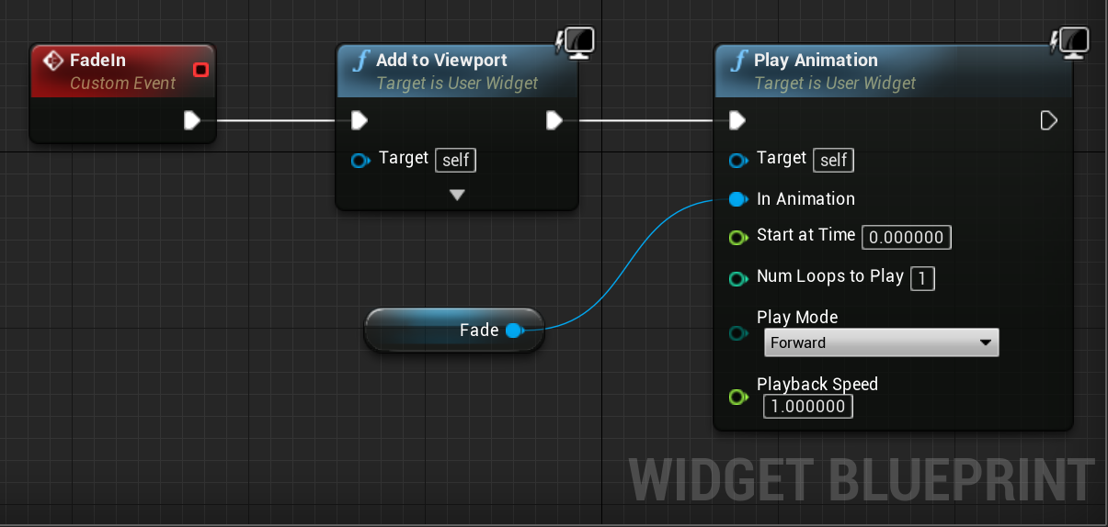
Tutorial: Quit Game

Slide 48
Tutorial: Quit Game

Slide 49
Feedback Design
Tutorial: Seamless Camera Movement

Slide 50
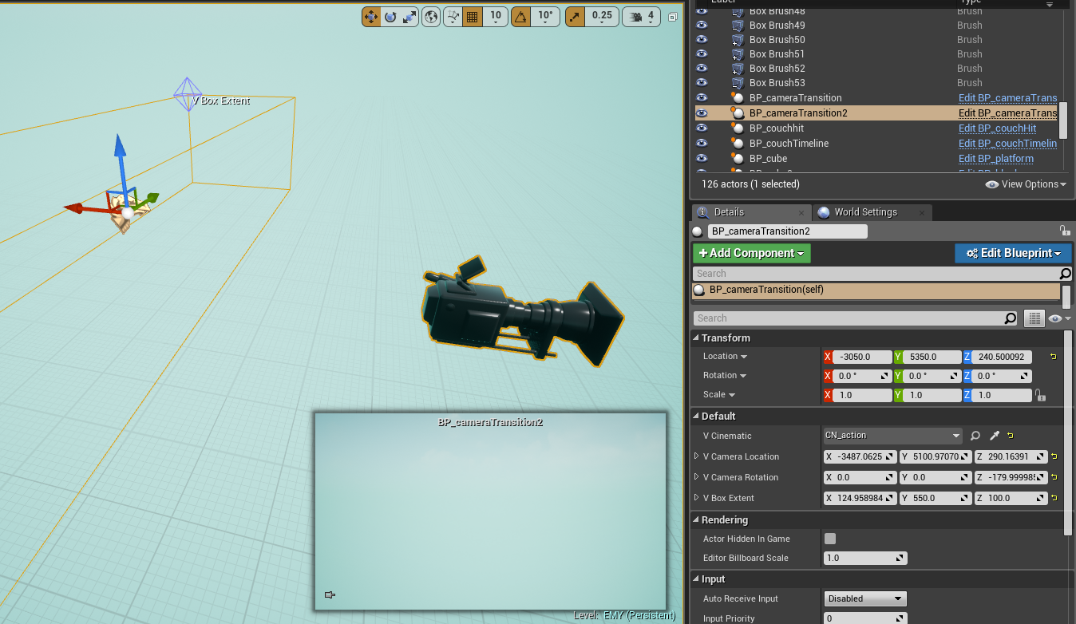
Seamless Camera Movement

Slide 51
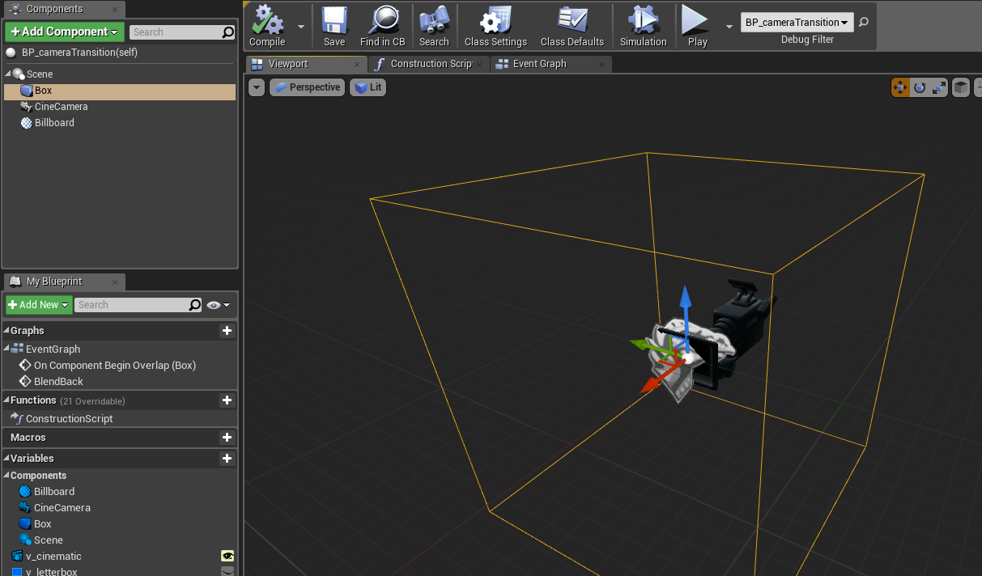
Seamless Camera Movement

Slide 52
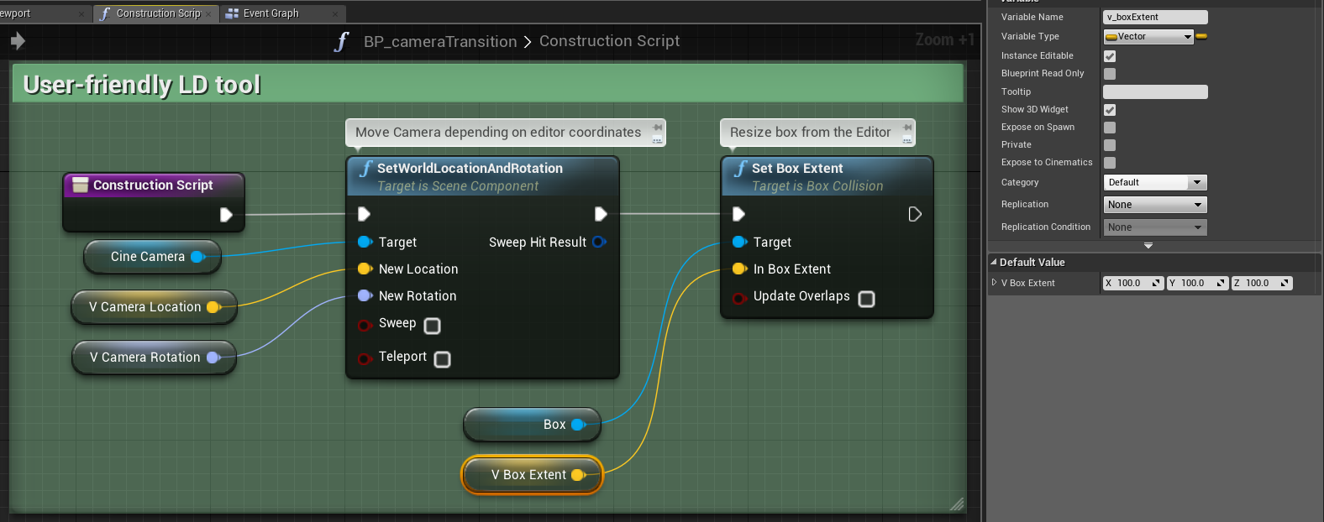
Feedback Design
Seamless Camera Movement

Slide 53
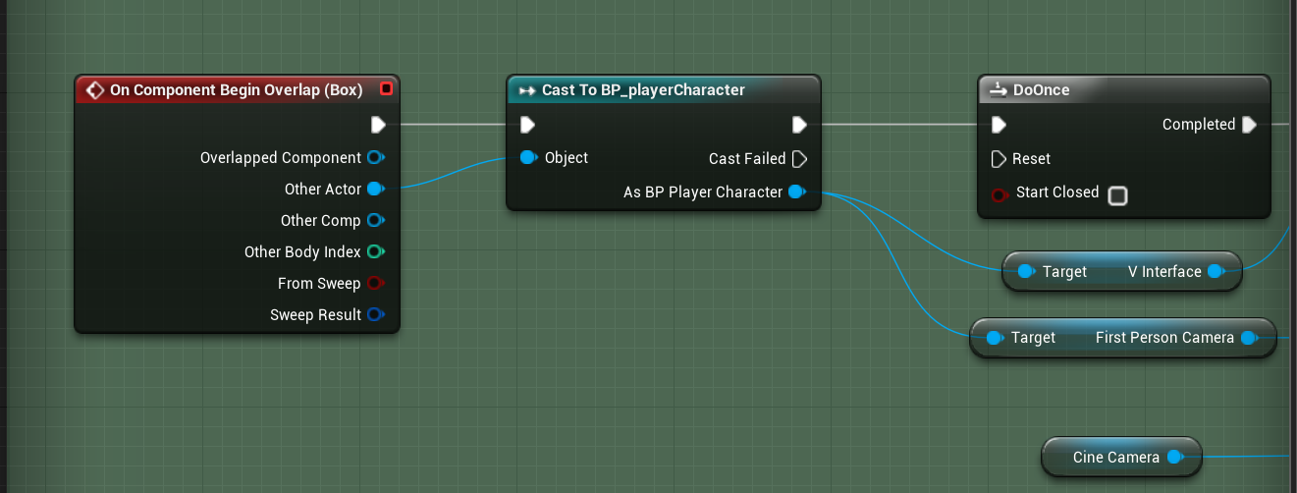
Feedback Design
Seamless Camera Movement

Slide 54
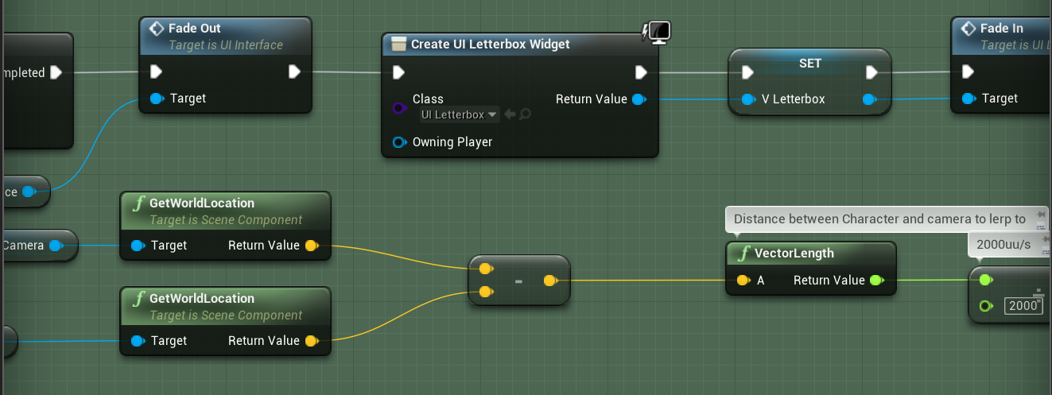
Feedback Design
Seamless Camera Movement

Slide 55
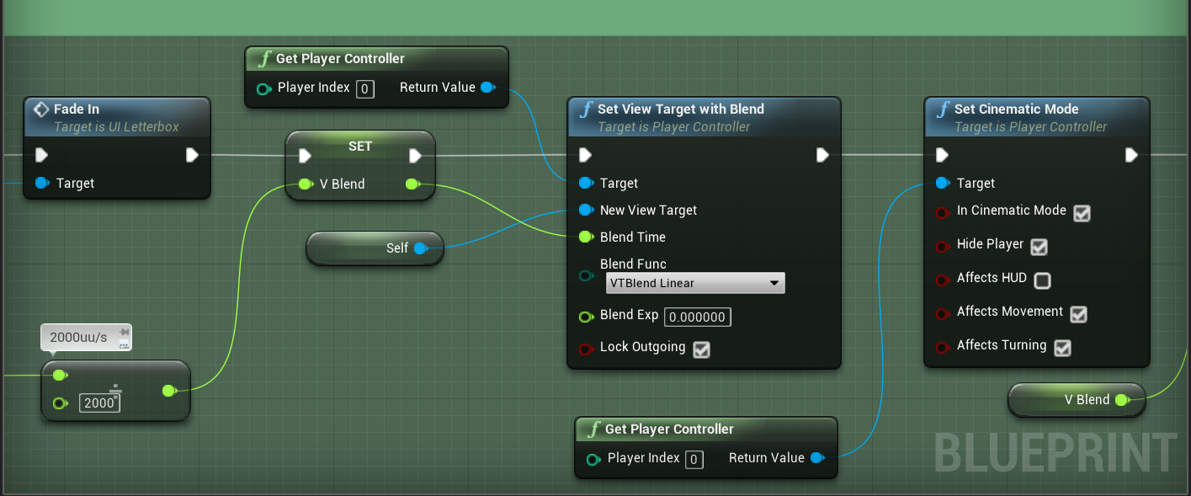
Feedback Design
Seamless Camera Movement

Slide 56
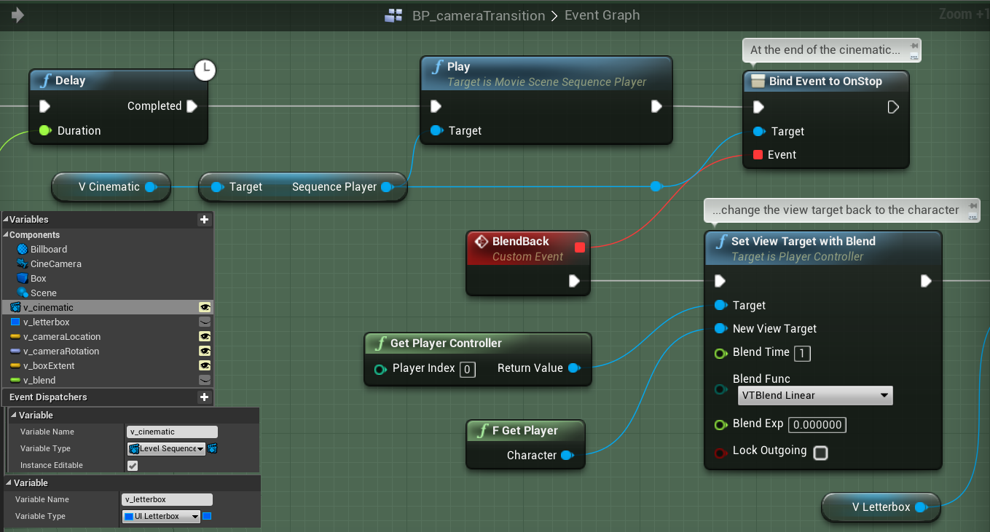
Seamless Camera Movement

Slide 57
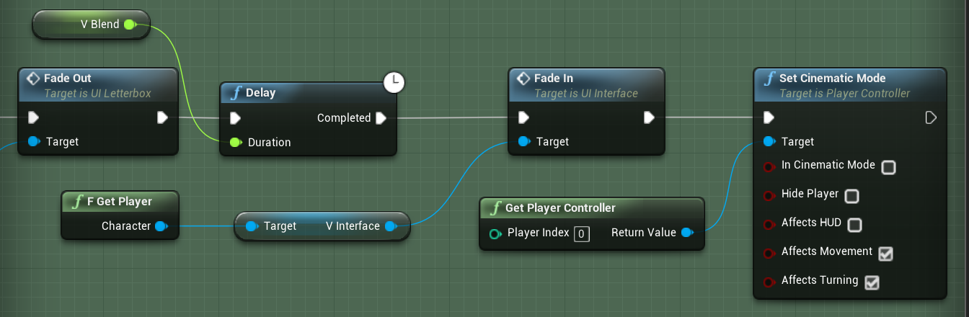
Feedback Design
Seamless Camera Movement

Slide 58
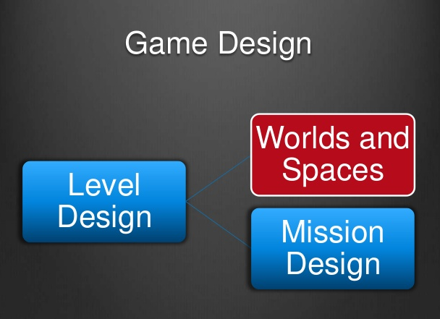
Feedback Design
Mission design/scripting is complicated but fun
Good missions combine narrative and gameplay in fun and cohesive ways
Good missions are clear and provide the player with incentive to continue playing the game

Slide 59
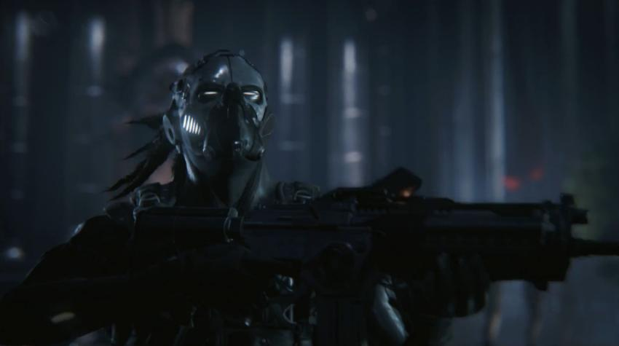
Feedback Design
Level Design 4
Unreal 4
Modular Design
Procedural Design
MegaCorp™
Cover Combat Level Design
Track Design
Level Design for Puzzle Games

Slide 60
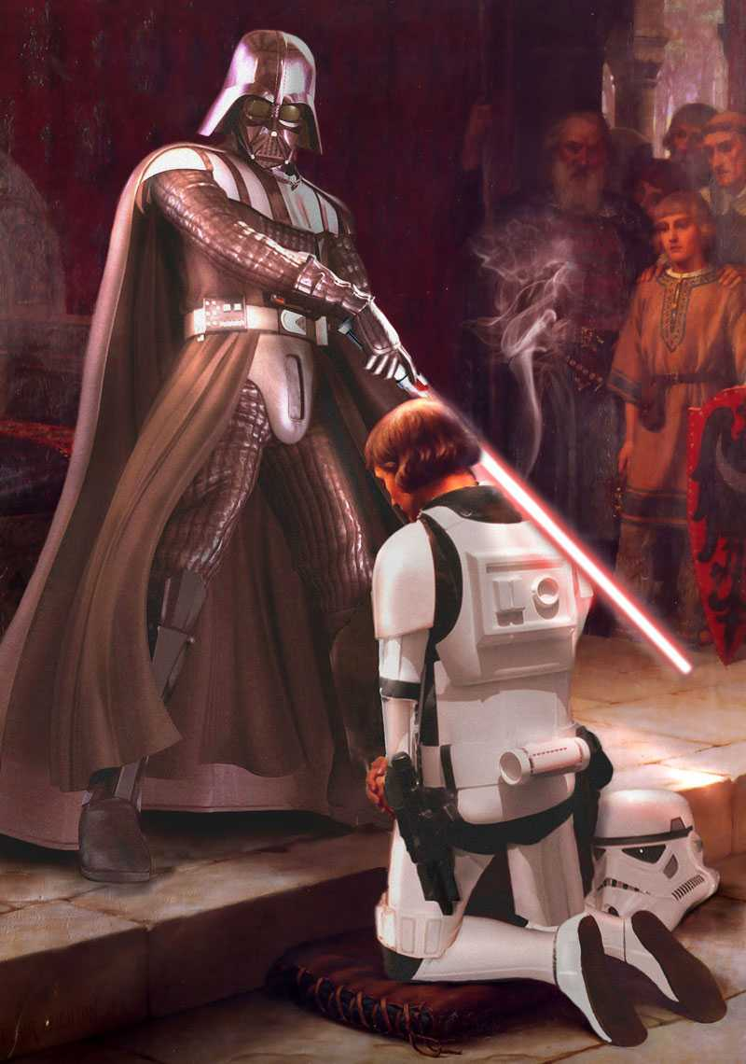
Feedback Design
Term 4 is coming!
See you next term!
Now you can shower.
have to

